Slide 1
Applied Regression and Multi-Level Modelling
Vincent van Hees
Statistics Interest Group, Amsterdam, 02/08/2018

Slide 2
Background – When to use regression analysis?
HumanEnergyExpenditure ~ BodyMovement + BodyWeight + Age + Handedness
What measurements are needed for reasonable estimation?
Does the model fit theory? If not, is there something wrong with the data?
ErrorSleepClassification ~ Weekday + Season + Age + Sex
In what parts of the data do we expect large errors?
HealthRisk ~ AlcoholConsumption + EducationLevel
Associations and dending on study design causality

Slide 3
What is multilevel regression?
A multilevel model is a regression in which the model coefficients are given a probability model:
Y_{i} = a_{j} + B_{j} x_{i} + error (compared with linear regression: Y_{i} = a + B x_{i} + error)
where j is the group
Why is this useful?
Helps to learn about effects that vary by group
Can handle: many levels of data, unbalanced sample sizes, and many input variables.

Slide 4
Key terminology
Fixed effects:
One model across all groups
Random effects:
Varying y-intercept across groups
Varying slope across groups
Nested versus Non-nested models

Slide 5
Example in R… from the book Gelman and Hill 2007
See also: http://www.stat.columbia.edu/~gelman/research/published/multi2.pdf

Slide 6
Kid IQ: Chapter 3 from Gelman and Hill 2007
How does IQ test score in kids related to mother?
Whether mother graduated from high school (1) or not (0)
IQ of mother (continuous)
Goal: Estimate distribution of radon levels across counties

Slide 7
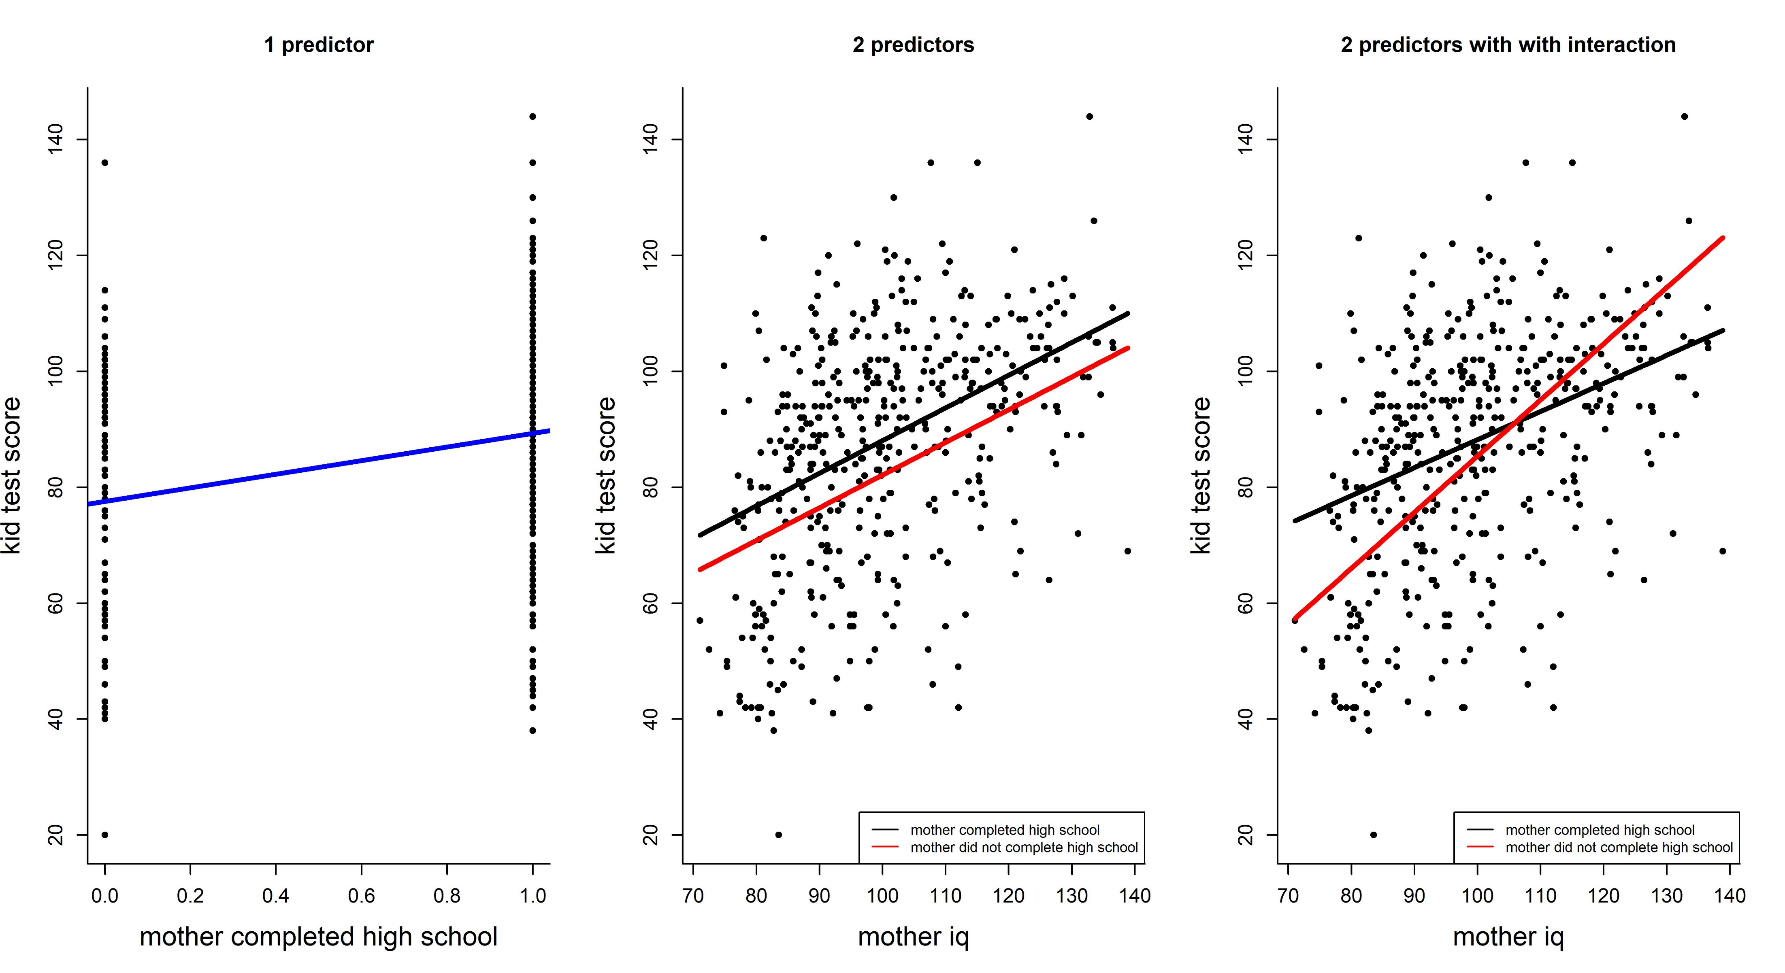

Slide 8
Radon measurements: Chapter 12 and 13 from Gelman and Hill 2017
Measurement of radon (A gas that may cause cancer):
Individual homes throughout the U.S.
Measured either in the basement (0) or ground floor (1)
80 counties
Known Uranium level in the soil of the county
Goal: Estimate distribution of radon levels across counties

Slide 9
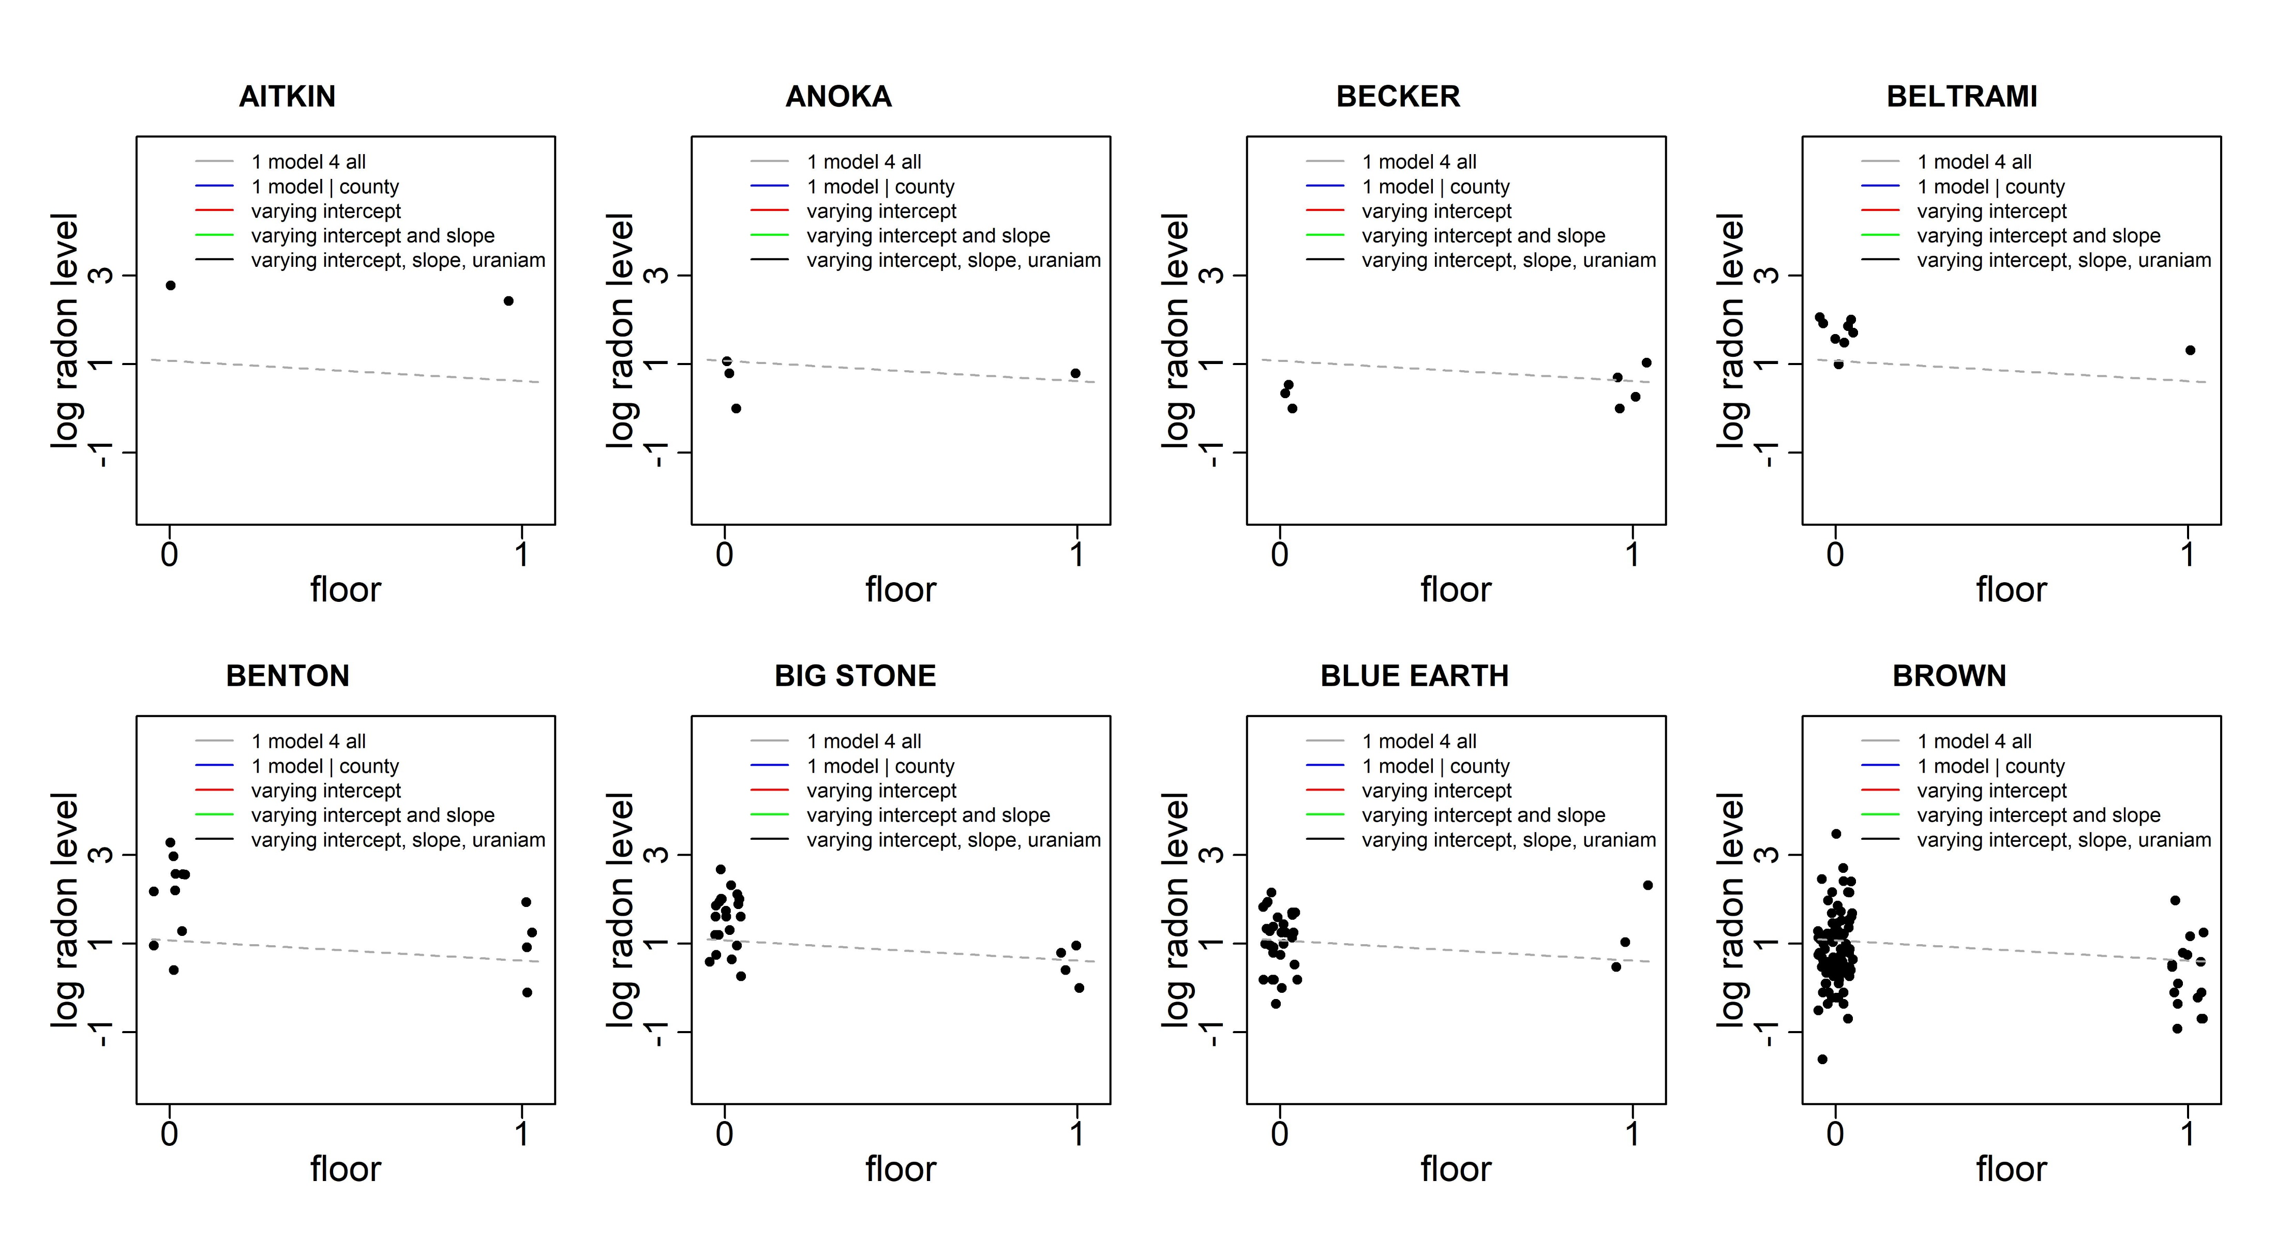

Slide 10
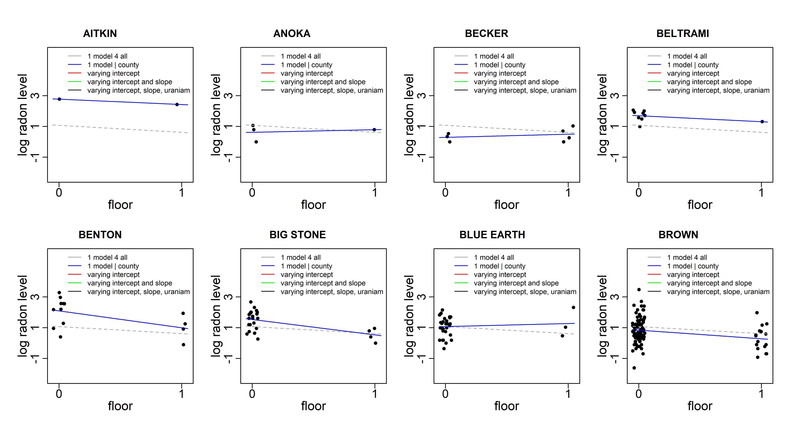

Slide 11
